Slide 1
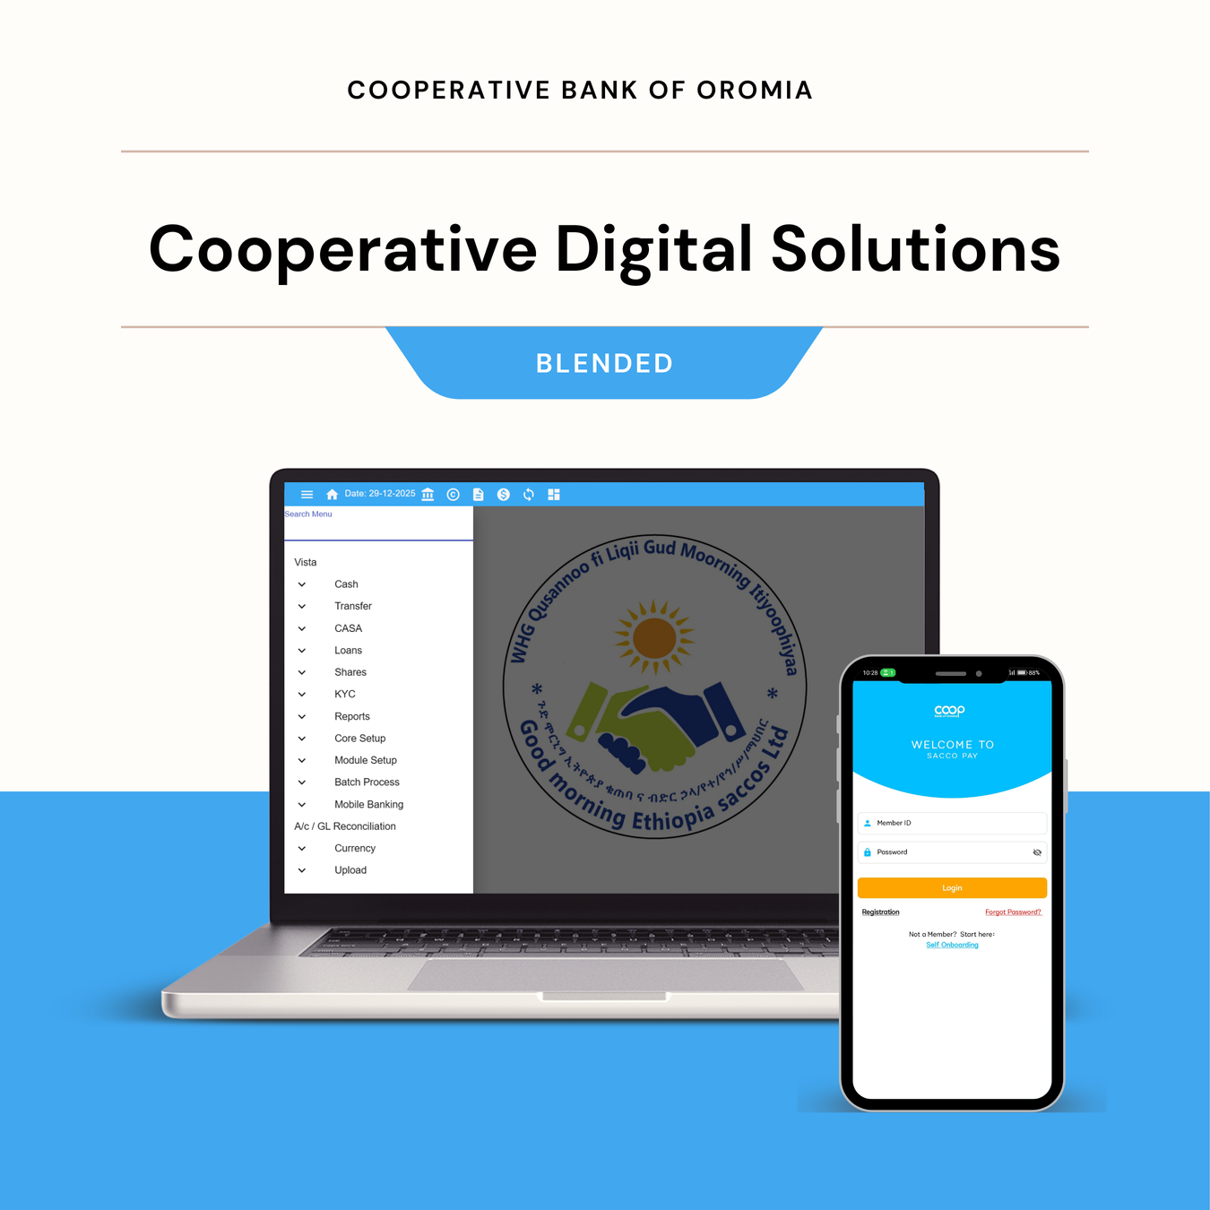




Introducing
SACCO-Link
Core Banking + Mobile Banking
Is an integrated Core and Mobile Banking platform designed for SACCOs and Unions to,
Digitize Manual Operations into automated, standardized, and secure digital systems.
Connect Members, SACCOs/Union, and the bank in real time
Enable Cooperatives to operate competitively like formal FIs, and
Generate Reports that support smarter financial and operational decision-making.

Slide 2




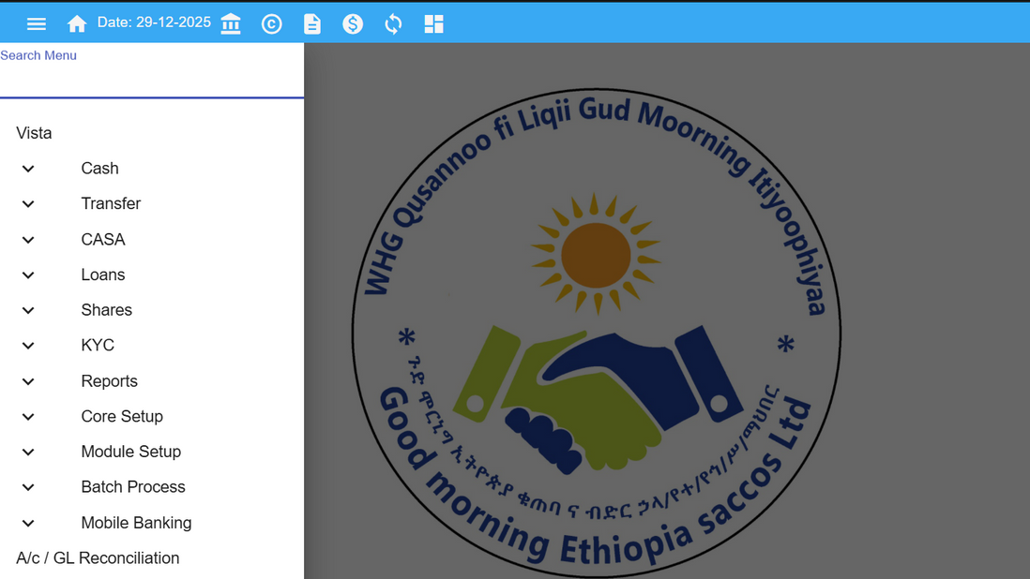


KEY Modules
Core Banking Features
Digital KYC
Loan Management
Clean, and complete members profile management
Account based Principal, interest and penalty calculation automations
Savings & Share
Seamless Financial Reports
Secure and transparent Savings, Share and Asset Management Module
Real-time Balance Sheets, Income Statements and TB Reports

Slide 3
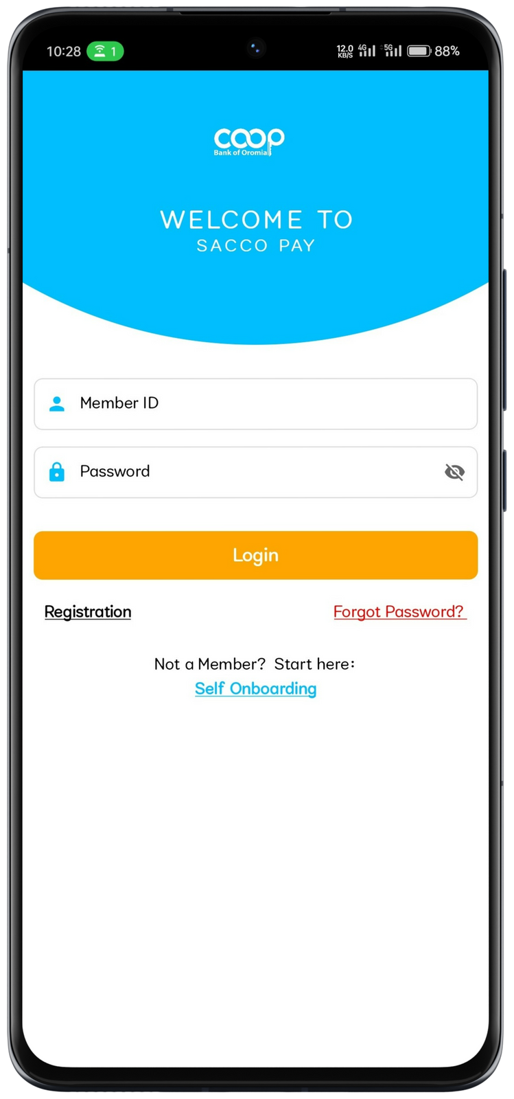
SACCOPAY MOBILE BANKING
Membership Application
Features
New Members can register themselves to SACCOs of their choice directly from the application.
Instant and Direct Payments
Loan Application
Savings Payments(Compulsory/Voluntary)
Loan Payments (Principal/Interest)
Pay using Bank or SACCOs Accounts
Enables existing members to apply for loans anywhere and anytime.
Accounts Management
View Account Balances
View & Download Accounts Statements
Manage SACCO Savings, Loan and Share Accounts
SMS Alerts and Receipts
SACCOs tailored SMS and Receipts of transactions
Features
Empowering Cooperatives with Technology

Slide 4
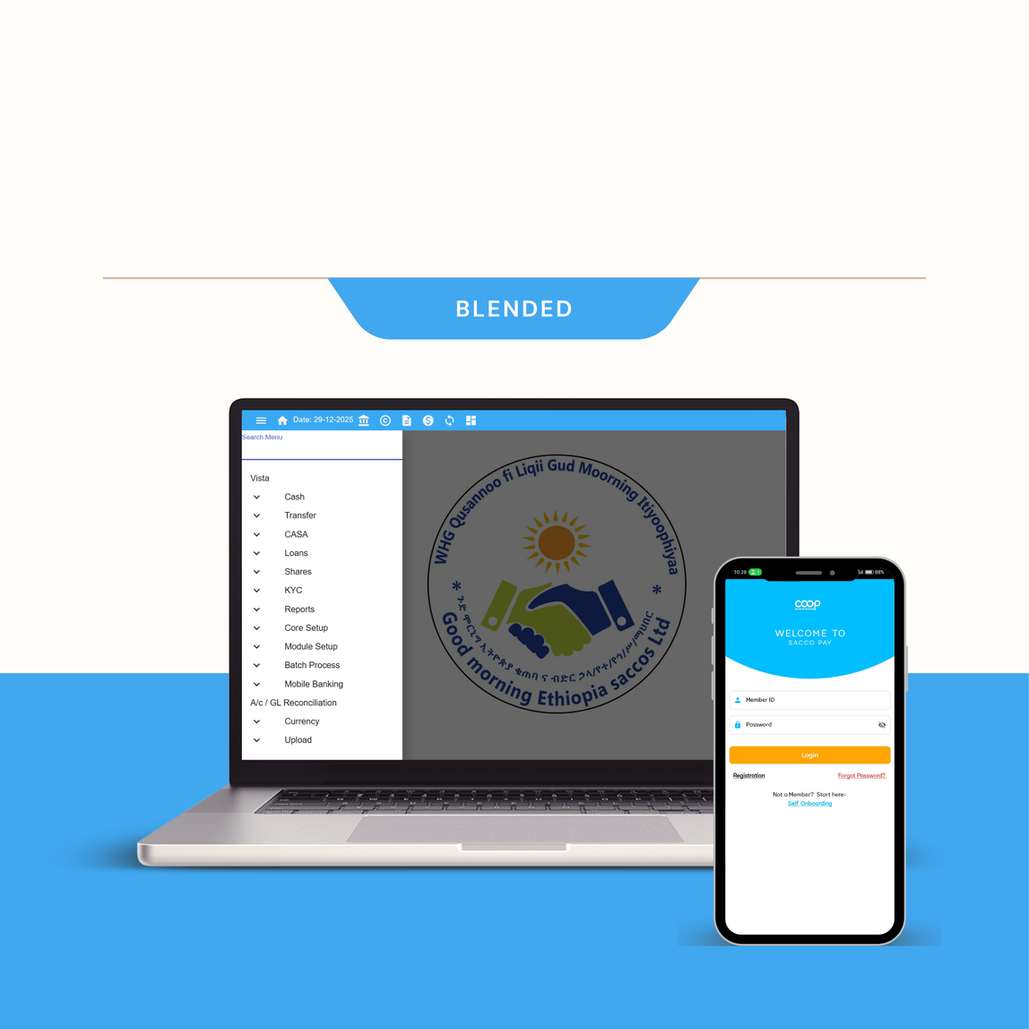



Cooperatives Digital Solution
Product Impact
The following are a high-level figures showing the SACCO-Link impact so far,
Onboarded
Integrated
Activated Mobile Banking
60
20
4
SACCOs + Unions
SACCOs + Unions
SACCOs
50K+
2K+
400M+
Individual Members
Primary Cooperatives
DEPOSITs MOBILIZED THROUGH THE PLATFORM

Slide 5

https://coopbankoromia.com.et/coopbank-sacco-link
+251-965-2964-02
Empowering Communities, Transforming Lives
Cooperative Bank of Oromia

